Slide 1

Reflexive Verbs and Particle se in BCS
& Expressing Attitudes/Feelings using Dative Case

Slide 2
Types of Verbs
Transitive/prelazni glagoli
Intransitive/neprelazni glagoli
Ja plačem. I am crying.
Reflexive/povratni glagoli-
Ja kuvam ručak. (I am making lunck). They can have a direct object.
the action leaves the subject and then returns to it.
Often describe the state, the action is not leaveing the subject.

Slide 3

Reflexive verbs
Transitive verbs (those that can be followed by the accusative case without a preposition, with a direct object) may reflect the action back on the doer by the use of reflexive particle se, oneself.

Slide 4
Types of Reflexive Verbs
Real Reflexive Verbs
šminkati se, umivati se
When you are both the subject of the action and its object
Reciprocal Reflexive Verbs
Pozdraviti se- to greet each other
Zagrliti se- to hug each other
Irregular Reflexive Verbs
Čuditi se- to get suprised

Slide 5
Example
Berberin brije vojnika. | The barber is shaving the soldier.
Berberin brije sebe. | The barber is shaving himself.
Berberin se brije. | The barber is shaving himself.
Vojnik se brije. | The soldier is shaving (himself).

Slide 6
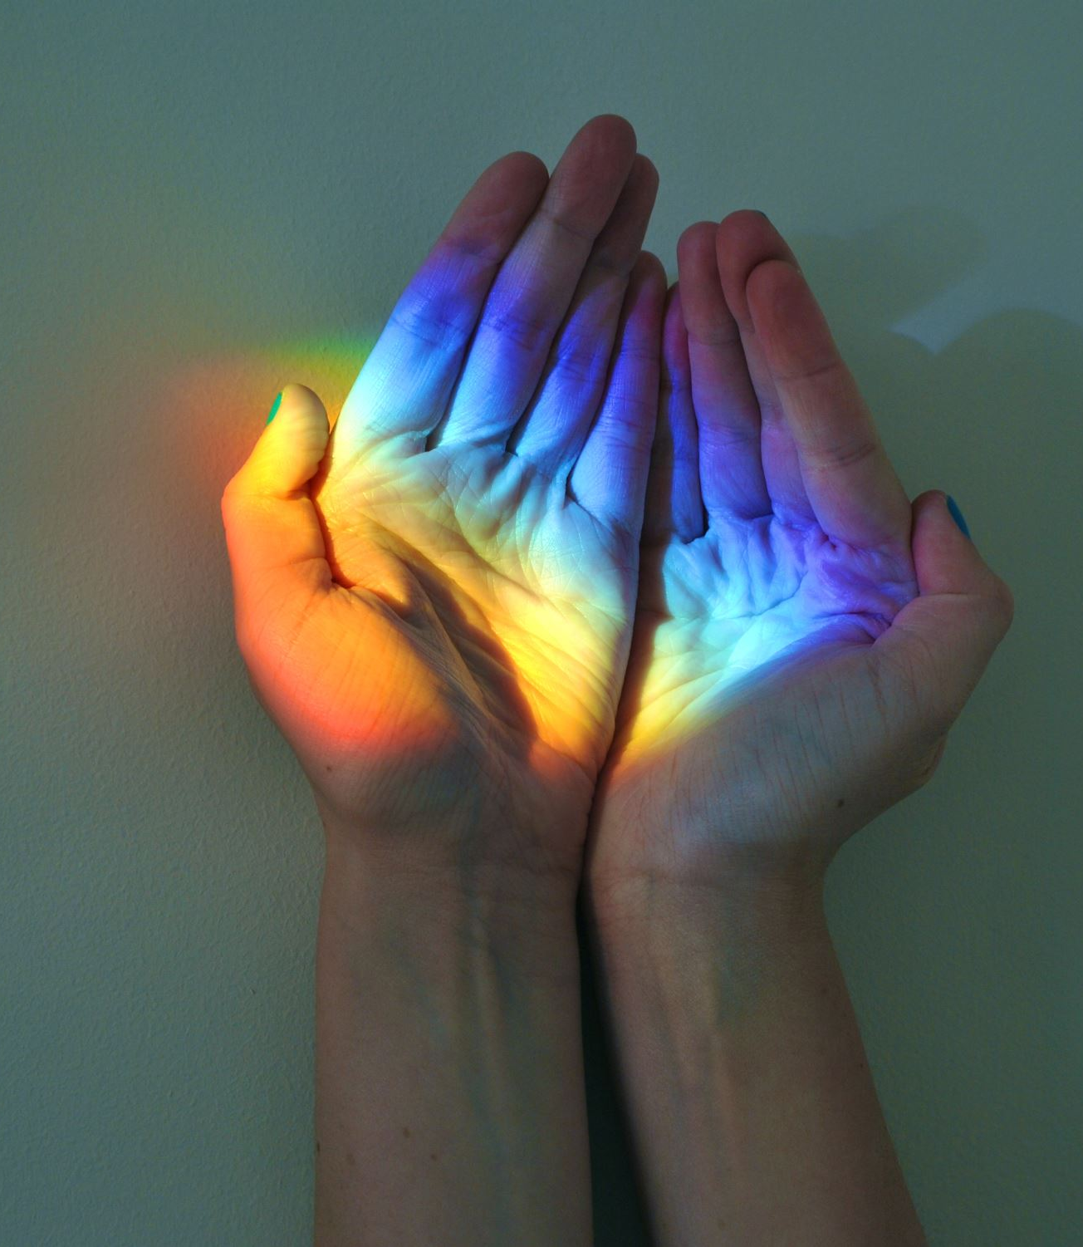
.
Reflexive Pronoun sebe, se
The forms sebe, se are the accusative and genitive case of the BCS reflexive pronoun whose English equivalents are ‘oneself, myself, himself, herself, etc.’
Sebe, se have no nominative forms, but exist only in reference to the subject of the sentence. They cannot themselves be the subject.

Slide 7
Primeri
Milan je video/vidio sebe (acc.) u ogledalu/zrcalu.
Milan saw himself in the mirror.
Milan se (acc.) video/vidio u ogledalu/zrcalu.
Milan saw himself in the mirror.

Slide 8
.
Note that after the prepositions only the stressed form “sebe” is used.
Ona se ljuti na sebe, a ne na tebe.
She is angry at herself and not at you.
Verbs such as videti/vidjeti se, brijati se, češljati se, prati se (to wash, bathe), kupati se, tuširati se (to take shower), umivati se (to wash one’s face), are the real reflexive verbs because “sebe” and “se” are interchangable without affecting the meaning.
To put it simple, in sentences with real reflexive verbs, the subject performs the action on himself, herself. There can be no direct objects used in conjuction with se. Because se is direct object.

Slide 9
Other meanings and functions:
A significant number of BCS verbs include the particle se as part of their meaning. This particle must accompany any conjugated form of the verb in question. The full range of meanings covered by se-verbs is broad.

Slide 10
Reciprocal Meaning
Verbs with se can have reciprocal meaning as in voleti se/voljeti se:
Oni se vole. They love each other.
The se of the reciprocal verb cannot be replaced by sebe without changing the meaning:
Oni vole sebe. They like themselves (i.e., they are egotists or narcissists)

Slide 11
Reciprocal Meaning Excamples
Takmičimo se za bolju ocenu. We’re competing for a better mark. (we are competing with each other, preforming action on the subject, us)
Ljubili su se. They kissed each other.
Oni se biju. They are fighting (meaning they are fighting each other)

Slide 12
Make a verb intrasitivive
The most frequent meaning is that which is most difficult to define: in essence, the addition of se to a verb acts to focus more attention on the verbal idea itself. One way it does this is to make a verb intransitive. A transitive verb by definition takes a direct object. Adding se to such a verb makes it intransitive: it deprives it of ability to take a direct object.

Slide 13
Zvati VS Zvati Se
Verb zvati to call, invite is transitive verb, requiring a direct object. Usually the object is explicitly stated (if not the speaker has one in mind.)
Majka zove sina svaki dan. Mother calls (her) son every day.
Njegovi prijatelji ga zovu Toma. His friends call him Toma. (Toma nickname for Tomislav)
The verb zvati se, by contrast has the particular meaning of identifying someone by name, stating what one is called. It is the addition of the particle se that affects this change in meaning.
Ja se zovem Ana, a on Toma. My name is Ana and his Toma.
Svi bankari se zovu Sem. All bankers are called Sam.

Slide 14
Makes passive forms.
Particle se can make the active verb passive:
Kazati (active) : Šta/što Ana kaže o tome? What Ana says about that?
Kaže lepe/ lijepe stvari. She is saying nice things.
Kaže se (passive:note it affects only 3 p. singular)
Kako se na hrvatskom/ bosanskom/ srpskom kaže flower?
How do you say a flower in BCS?
To se samo tako kaže, znaš.
That is just how people talk, you know.
Two verbal forms zove se and kaže se are so frequent in BCS as to be fixed expressions.

Slide 15
Some other examples of this type are:
Voziti to drive a vehicle+acc :
Vozim autobus. I am driving a bus.
Voziti se to ride u+loc or inst:
Vozim se u autobusu. I am riding on the bus.
Vozim se autobusom. I am riding by bus.
Vraćati to return +acc:
Vraćam knjige u biblioteku/knjižnicu. I am returning books to the library.
Vraćati se to come back
Vraćam se iz Španije/Španjolske. I am coming back from Spain.

Slide 16
.
Naljutiti to anger someone +acc:
Unuk je naljutio dedu/djeda. The grandson made his granpa angry.
Naljutiti se to get (become) angry rather than to anger oneself, a true reflexive meaning:
Unuk se naljutio na dedu/djeda. The grandson got angry with his grandpa.

Slide 17
.
Se is frequently found only with 3rd person singular forms in BCS equivalent of the passive voice or impersonal sentences.
Praviti rakiju -to make brandy; praviti transitive verb, takes a direct object
Irfan pravi rakiju od šljiva. Irfan makes plum brandy.
Rakija se pravi od šljiva. Brandy is made of plums. (focus is how brandy is made, not who is making it (that is why logical subject is omitted))

Slide 18
Ocenjivati /ocjenjivati studente-to grade students:
Na Balkanu se studenti strogo ocenjuju/ocjenjuju.
In the Balkans the students are graded strictly.

Slide 19
.
Saditi cveće/ cvijeće -to plant flowers:
Cveće/ cvijeće se sadi na proleće/ proljeće.
Govoriti bosanski/ hrvatski/srpski
Ovde/ovdje se govori bosanski/ hrvatski/ srpski. BCS is spoken here.
Kupovati karte- to buy tickets:
Karte se kupuju na autobuskoj stanici/autobusnom stajalištu. The tickets are purchased at the bus station.

Slide 20
Jesti lubenicu- to eat watermelon
Lubenica se ovako jede .Watermelon is eaten in this way/ like this.
Primati studente -to accept (enroll) students
Novi studenti se primaju od 1. juna/lipnja do 15 septembra/rujna. New students are accepted (enrolled) from June 1 to September 15.

Slide 21
Impresonal sentences with se
There are several types of impersonal sentences in which 3rd person singular (no plural) of both transitive and intransitive verbs (with or without se) can be used accompanied by se to express general statements in which the subject is not present. The English equivalents have as subjects either a noun or pronoun, or indefinite pronoun one. They may also be expressed in the passive voice with it in which it has no antecedent.
Govori se... It is said or people say...

Slide 22
Još primera
Ovde/ovdje se malo radi, a mnogo priča. Here little is done but much talk is heard.
U ovom restoranu se dobro jede. One eats well in this restaurant.
Odavde se dobro vidi. One can see well from here.

Slide 23
.
Oblači se. It is getting clowdy. Oblačiti se means to get cloudy and to dress up. The difference is in accent in present tense: Oblači se (long a means He/she is dressing up) Oblači se (stress on O: it is getting cloudy)
Note that these sentences have the neuter form of the participle in past tense, since there is no subject to agree with.
Govorilo se, mislilo se.. People talked about, thought about ...
Ovde/ovdje se malo radilo, a mnogo (se)pričalo. Here little work but much talking was done.

Slide 24
Verbs: meaning to like smth
In English verbs like and love take direct objects. By contrast most BCS verbs take dative case. The one which does not take dative is voleti/ voljeti which is followed either by infinitive or da+present tense or a noun/ pronoun in the accusative case.
Jako volim da putujem/putovati. I really like to travel.
Volim pse, ali ne volim mačke. I like dogs, but I do not like cats.
Volim ga puno. I love him a lot.

Slide 25
.
There is a difference between to like and to love in BCS. You can love a person, people, animals, music, literature, history. Remember you cannot love a blouse, shoes, jacket, bag, etc. (prosaic things/objects!!!) Instead of the verb to love, to like is used: sviđati se /dopadati se:

Slide 26
In BCS the one doing the liking is expressed in the dative case, and that which is liked is expressed in the nominative case. To say John likes cookies one must construct a sentence on the model Cookies are pleasing to John to make proper BCS sentence.
The dative noun/ pronoun (only short form) must precede se directly (long forms come after se and the main verb)

Slide 27
.
Kako ti se sviđa/dopada moj novi auto? How do you like my new car?
Kako se tebi sviđa/dopada moj novi auto?
Mnogo mi se sviđa/ dopada. I like it a lot.
Ani se ne sviđaju/dopadaju slatkiši. Ana does not like sweets.
Sviđa mi se taj momak. I like that guy.

Slide 28
Subjectless sentences and the dative case:
Subjectless sentences often identify states. If they include dative forms referring to human beings the meaning is that the humans in question are affected somehow by that state. In English, the person in question is expressed as the subject of the sentence the person either is or feels a particular way. BCS grammar, by contrast, ascribes the state in question to the person, expressing the person in dative case. This formula is the same regardless of whether it is a general statement or specific state ascribed to a particular person.

Slide 29
.
General: Toplo je ovde/ovdje u sobi. It is warm here in this room.
Specific: Meni je u ovoj sobi toplo. I am warm in this room.
G: Teško je u početku. It is hard at the outset.
S: Meni je uvek/ uvijek teško u početku. It is always hard for me at the beginning.
G: Ovde/ovdje je dosadno. It is boring here.
S: Njima je ovde/ovdje dosadno. They are bored here.
G: Kako je? Dobro je. How is it going? Fine.
S: Kako ti je? Dobro mi je. How are you? I am fine/I am O.K.
S: Kako mu je? Grozno mu je. How is he? He feels awful.

Slide 30
.
If you find yourself being in a state of sorry or being pleased or indiferent the same model is followed:
Žao mi je da to čujem. I am sorry to hear that.
Drago mi je da te vidim. I am glad to see you.
Nama je drago da vas vidimo. We are pleased to see you.
Svejedno mi je. or Meni je svejedno. I do not care. It is all the same to me.
Svejedno nam je. We do not care. It is all the same to us.

Slide 31
.
Verb činiti se -to seem can be used in subjectless sentences. The person to whom somehing seems a certain way is expressed in the dative. One should avoid literal English translations of the form it seems to me. BCS sentence beginning with čini mi se should be translated I think, since in BCS this construction actually conveys a greater real-world involvement of the human being in question in the particular state or situation:
Čini mi se da je sad sve u redu. I think everything is o.k. now.
Čini mu se da ništa ne zna. He thinks he does not know anything.
Čini mi se da nešto čujem. I think I hear something.
I meni se tako čini. I think so, too.

Slide 32
***
To get back to reflexive verbs again. Here are 4 groups of verbs that should help you understand the basic meanings of reflexive verbs and their nonreflexive equivalents:
Group 1: Verbs that are only reflexive (they don’t have reflexive-less partner):
Dešavati se:to happen
Šta/što se dešava? What is happening/going on?
Sviđati se/ dopadati se: to be pleasing, to like
Sviđa mi se ova zemlja. I like this country.
Sastojati se: to be composed of/to consist of
Ova knjiga se sastoji iz osam poglavlja. This book has/ contains/ is composed of 8 chapters.

Slide 33
Group 1
Bojati se: to be afraid of
Bojim se mraka. I am afraid of darkness.
Bojim se zla. I am afraid of evil.
Ne bojimo se bolesti. We are not afraid of illness.

Slide 34
Group 2
Verbs that do exist in one meaning without se, but in a completely different meaning with se
Čini se (3 person sg only) it seems
Čini se da je pao mrak- It seems that it is getting dark.
Činiti: to make, to do
Činim sve za tebe. I do everything for you
Radi se o../(3 person sg only): it is a matter of , it is about...
Radi se o teškoj situaciji. It is a matter of a difficult situation.
( if you speak Russian, the equivalent is речь идёт о …)

Slide 35
Group 2
Raditi: to do, to work
Radim po ceo/cijeli dan. I work all day.
Nalaziti se: to be located
Knjiga se nalazi na stolu. The book is (located) on the table.
Nalaziti: to find
Nalazio sam mnogo zanimljivih biljaka u toj šumi. I found many interesting plants in that forest.

Slide 36
Group 3
adding se makes verb intransitive or passive general meaning of both verbs is preserved:
Jede se /jedu se
Ovako se jede banana. This is how one should eat a banana.
Da li znaš gde/gdje se ne jedu jagode? Do you happen to know where strawberries are not eaten?
Jesti: to eat
Jedem sendvič sa šunkom svaki dan. I eat ham sandwich every day.

Slide 37
Group 3
Sluša se : to be listened to (if a course at the university then translate to take course! Slušati kurs)
Kakva se muzika/glazba sluša na Balkanu? What kind of music (lit. is listened) popular in the Balkans?

Slide 38
Some more examples for group 3 and 4:
Group 3 :
active meaning- slušati /to listen to take (courses):
Svaki student sluša 4 kursa po semestru. Every student takes 4 courses per semester.
passive meaning:
Kursevi se slušaju 4 godine. Courses are taken for 4 years.
Moram da jedem meso redovno/redovito. I have to eat meat regularly.
A, ja kažem da se meso ne mora jesti. And I say that meat need not be eaten.

Slide 39
.
Group 4:
-Mediha svako jutro zove svog momka. Mediha calls her boyfriend every morning.
-Ona se zove Jovana. Her name is Jovana.
-Svaki put ga teško nalazimo. We always have a hard time finding it.
-Gde/gdje se nalazi banka? Where is the bank? (where is it located)?

